Slide 1

CRM Analytics For Marketing
DS-680 Marketing Analytic & Oper Research
Rohith Sanku

Slide 2
Objective
The objective of this project is to optimize marketing campaigns, enhance customer engagement, and drive revenue growth for the organization by leveraging CRM data.
This will be achieved through the implementation of RFM (Recency, Frequency, Monetary) analysis and item-based collaborative filtering techniques.
By gaining insights into customer behavior, preferences, and purchase patterns, we aim to tailor marketing strategies, improve customer satisfaction, and maximize revenue generation opportunities.

Slide 3

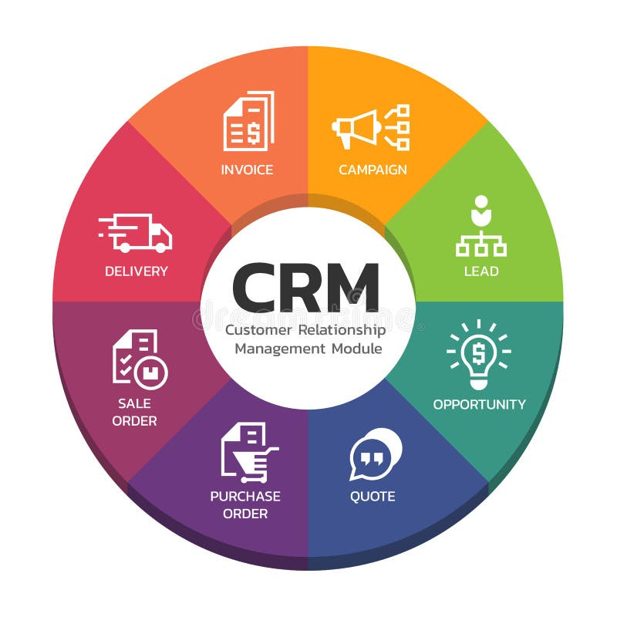
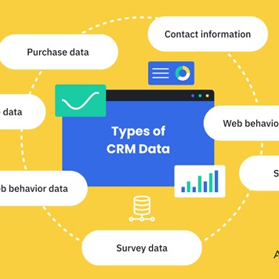

CRM- stands for Customer Relationship Management. It is a technology system that businesses use to manage interactions and relationships with both current and potential customer.
CRM Stores Customer information and Campaign to Invoice data.

Slide 4
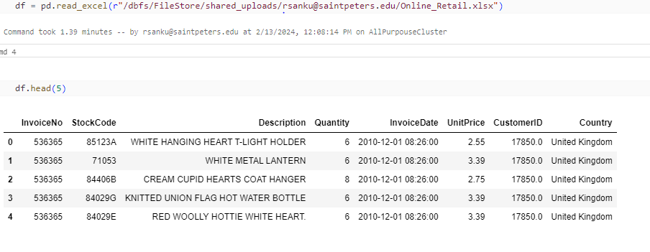
Data set contains all the transactions occurring for an online retail. The company mainly sells unique all-occasion gift-ware. With Rows 53 K rows and 8 columns.

Slide 5
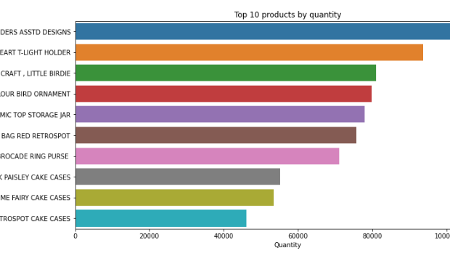


Data analysis

Slide 6
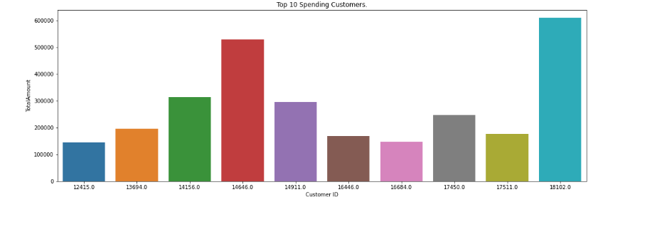
Data analysis

Slide 7
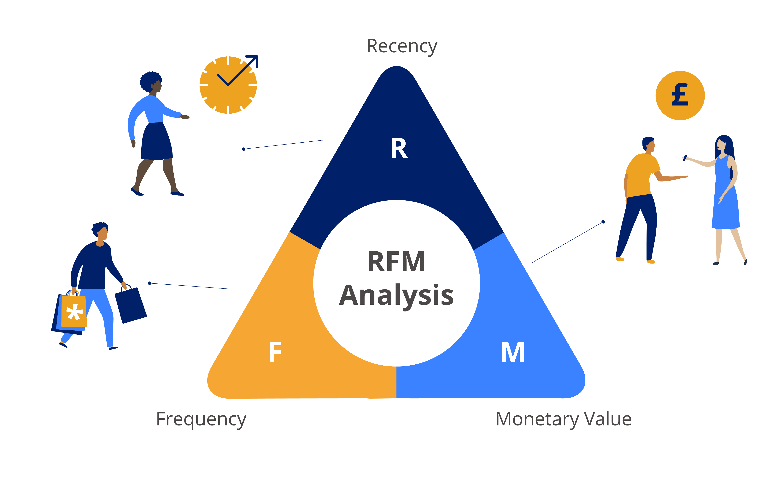
RFM Analysis
RFM is a method used to analyze customer value. RFM stands for RECENCY, Frequency, and Monetary.
RECENCY: How recently did the customer visit our website or purchased
Frequency: How often do they visit or how often do they purchase?
Monetary: How much revenue we get from their visit or purchase
The RFM Analysis helps the businesses to segment their customer base into different groups so that they can engage with each group with different targeted marketing strategies.

Slide 8
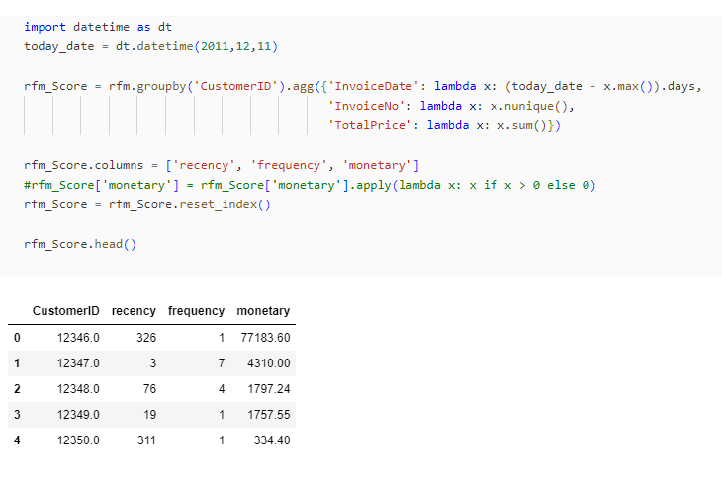
Recency score= Current date – Recent purchase date Frequency = Number of purchases Monetary = Total spendings

Slide 9
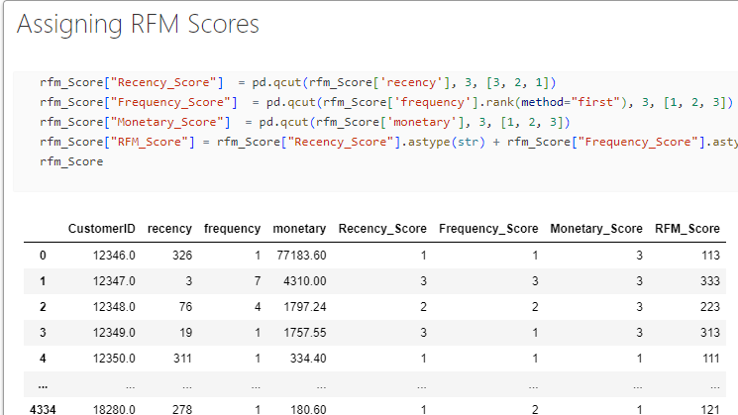

Slide 10
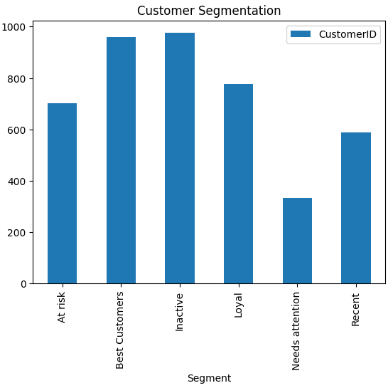
Marketing by Customer segments Best Customers - Personalized Emails, exclusive offers, or VIP event Loyal -Personalized Recommendations, targeted promotions or incentive Recent -Welcome Offers, Follow-Up Communication, Product or Brand Education Need Attention - Re-Engagement Campaigns, Customer Surveys, incentives At Risk - Proactive Communication, Targeted Marketing, Retention Offers or discounts In Active - Win-Back Campaigns ,Last-Chance Offers, Personalized Outreach
"Acquiring a new customer is anywhere from five to twenty-five times more expensive than retaining an existing one.” - Harvard Business Review

Slide 11
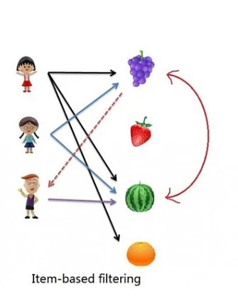
Collaborative filtering- It is technique used in recommendation systems to predict a user's preferences for items or products based on the preferences of similar users.
Two Types:
User-based collaborative filtering
Item-based collaborative filtering
For this dataset I used Item – Based Collaborative.
Item – based collaborative filtering :- It was first invented and used by Amazon in 1998. It used in recommender systems to suggest items to users based on similarities between items themselves.

Slide 12
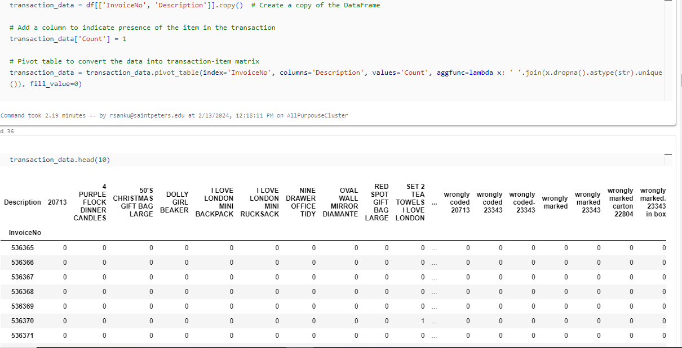

Slide 13
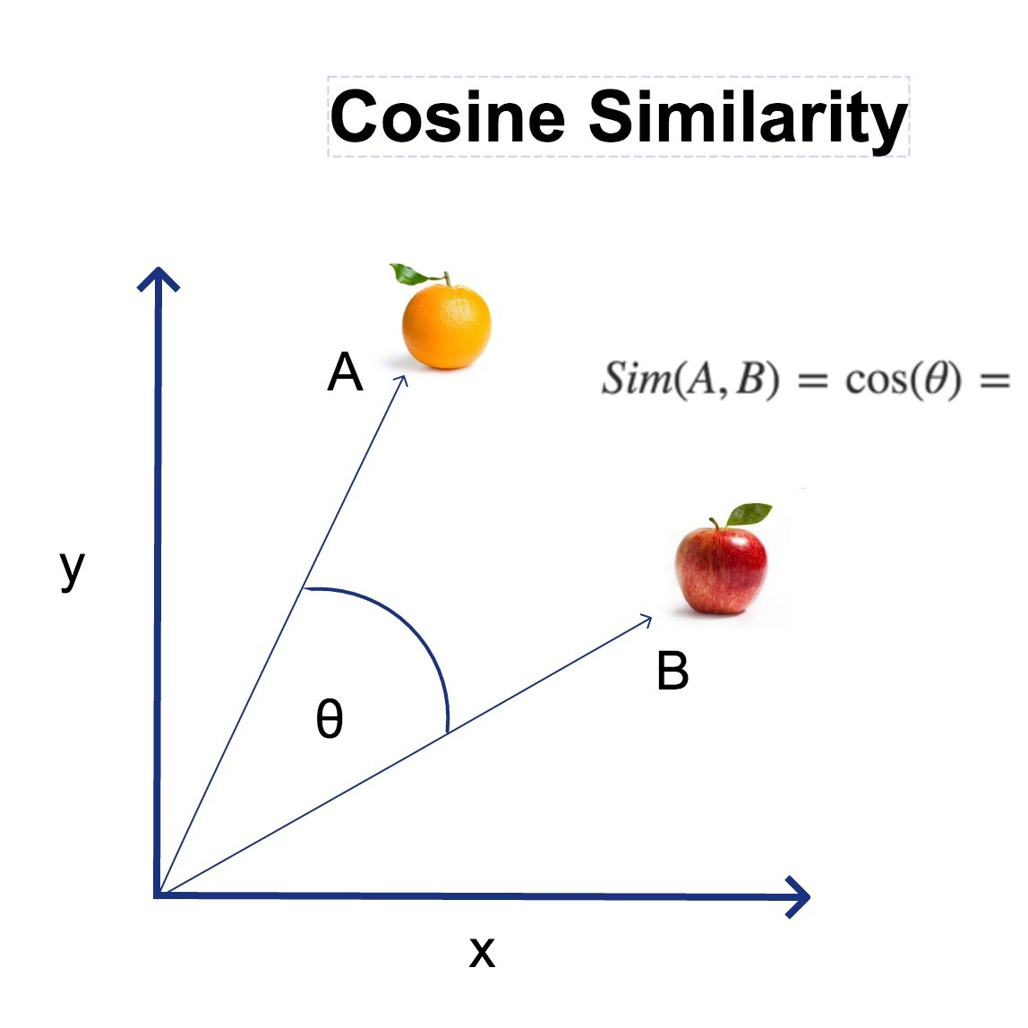
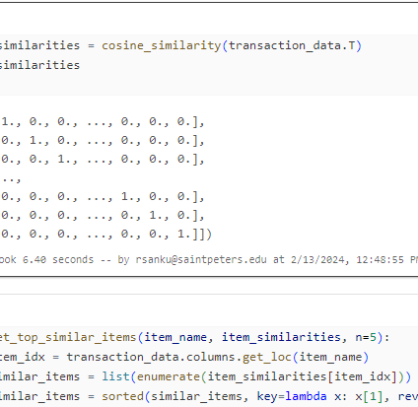
Cosine Similarity
Cosine similarity measures the similarity between two products. It is measured by the cosine of the angle between two products and determines whether two products are pointing in roughly the same direction.

Slide 14
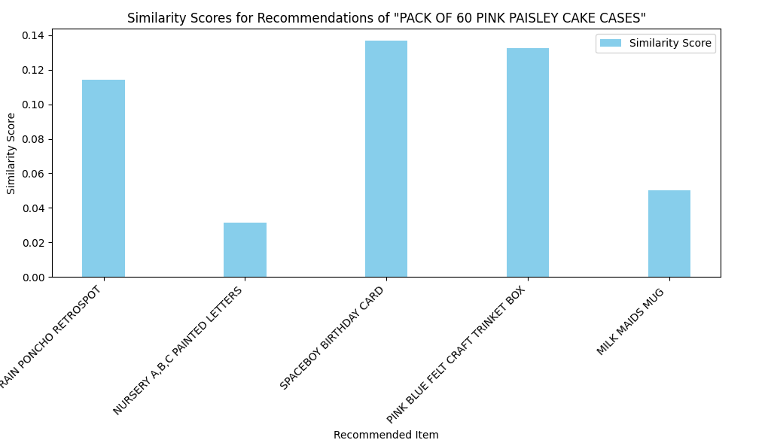
By identifying items that are most similar the target item based on their transaction patterns, the system recommends these similar items to users who have interacted with or shown interest in the target item. Users may find these recommended items appealing based on their similarity to the target item, potentially leading to increased engagement and sales.

Slide 15
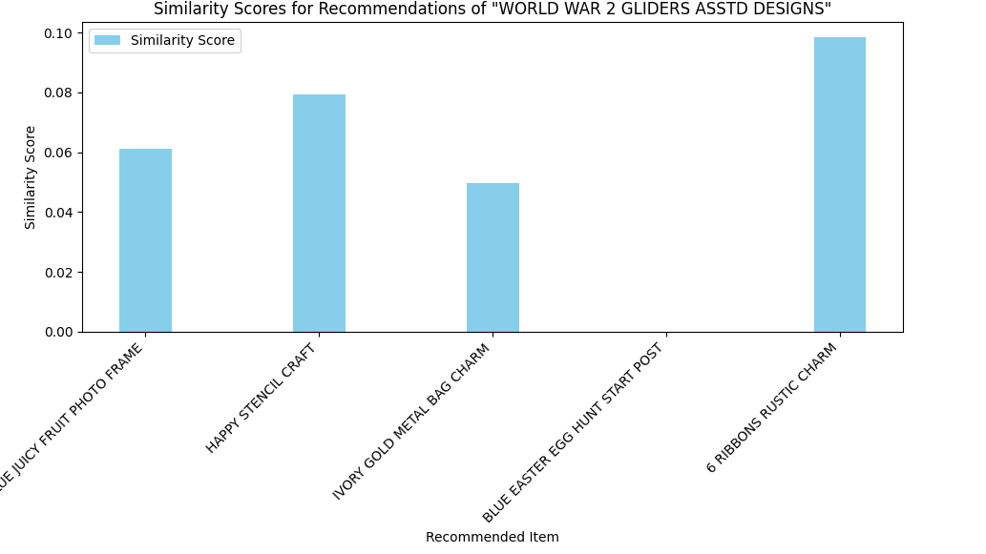
Suppose a customer purchases a world war 2 gliders from the company's online store. Using item-based collaborative filtering, the system identifies other items that are similar to the purchased item, such as photo frame, craft or accessories that complement to the item. The system then recommends these similar items to the customer through personalized marketing emails or on the website's "Recommended for You" section, increasing the likelihood of additional purchases and improving customer satisfaction.

Slide 16

Thank You! Rohith Sanku

